Slide 1
Welcome
Video Editing Workshop

Slide 2
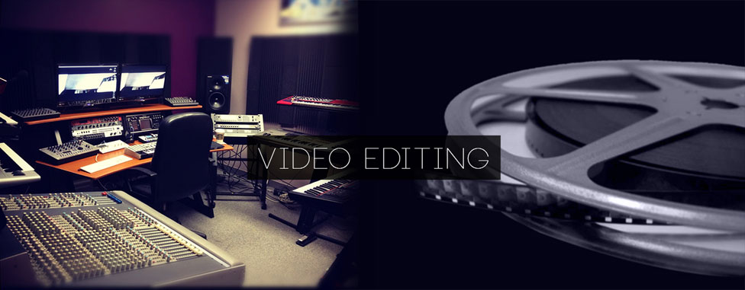
Introduction
What is Video Editing?
It’s the changes made to the clip to make it better or more appealing to the audience.
01

Slide 3
Output
What we shall be making today
02

Slide 4
Output
VIDEO NOT EMBEDDED FOR UPLOADING PURPOSES
03

Slide 5
Types
Simple
Video Editing
In which you work on some photos or videos & make a full movie out of it.
Media stiching with audio mixing & use of preset transitions or overlay effects
Limited Control over effects
Eg: Aftermovie, Slidshow, Teasers,etc...
Advanced
Video Making
In which you make the video from scratch. There may or may not be any
media in it.
Make y`our own transitions, effects, and
Full control over everything
Eg: Presentation, App / Product Promoti1on, Teasers,etc...

Slide 6
Requirements
A laptop or Desktop (recommended) with medium – high power
Core 2 Duo or higher powered processor with clock speed greater than 1.8 ghz
A resolution higher than 1366* 768 for optimal usage
NVIDIA or AMD Graphics card
HDD with rpm higher than 5400 or SSD
Windows or Mac OS (adobe recommended)
4

Slide 7
Rules & Conditions

Slide 8
Smooth & Continuous The Audience must not notice the cuts between the video or audio. The changes or transitions should be smooth and unnoticeable.
Audio – Video Link
The audio must match and co-ordinate with the video.
*These will help you to create a smooth & continious movie. It is not madatory to follow them, it’s just logic!
5

Slide 9
Transitions This is an important factor in making videos. All your pictures & videos are interconnected mainly by this.
Instead of using different transitions, try to stick with one or a set of transitions. That’ll make the video look professional.
Font Selection
Always choose the font depending on your video style.
Eg: If it’s a party after movie, then use a funky font
OR
If it’s a business presentation, then use a clean & elegant font.
*These will help you to create a smooth & continious movie. It is not madatory to follow them, it’s just logic!
6

Slide 10
Colour Scheme
This is a main factor for the video. The text should be visible at all angles.
Recommended: Light Background with dark text
OR
Dark Background with white text
Also, try to stick to a set of colours throughout the video to make it look more professional.
*These will help you to create a smooth & continious movie. It is not madatory to follow them, it’s just logic!
7

Slide 11
Process
Planning
Design
Render
8

Slide 12
Planning
HOW?
Audio
What type of Audio will match the video?
How can you make what’s there in your mind?
Duration
Photos / Videos
Render Settings
What will be the duration of the whole movie?
What kind of media can I put in there?
How should I output the file?
9

Slide 13
DESIGN
Mainly depends on the Software we use

Slide 14
What Software do we use?
Some of the common known video editing softwares
Corel VideoStudio
Nero VideoEditor
Cyberlink PowerDirector
Windows Movie Maker
Sony Vegas Pro
Resolve
Premiere Pro
After Effects
ProShow Producer
Pinnacle Studio
AVS Video Editor
Final Cut Pro
After Effects
Avid
Magix Movie Edit
63
10

Slide 15
What we’ll be learning?
Cyberlink PowerDirector
After Effects
The best software for major works of video editing which doesn’t include intense knowledge about the details
Advanced Video editing OR making software with a vast variety of usages & implementations with the help of thrid part plug-ins
Note: We chose these two products as they are the best available from each category all-in-all.
11

Slide 16
Cyberlink PowerDirector Usages
We’ll be able to make photo/video slideshow
Add & edit music along with it
Combine channels for flexible editing
PowerTools
Adjust the video speed, dimension, stability, noise, fading, motion, keyframe adjustments of all effects
Colour Correction
Adjust the color, temperature, gradient ,
Common
Bend
Transitions
Choose the best among the transitions provided.
Effect
Select and modify the effects provided
Control
You have precise control over your timeline with the quick clipping tool and more...
Combine
control
12

Slide 17
Install Cyberlink PowerDirector
Run Setup
Or just open the ReadMe file. It’s all written there.
Install
The installation pics are also given along with the setup.
Disable Anti-Virus
This is crucial to crack. You have to disable all the anti-virus & spyware to crack this software.
Crack
Once this is done, restart and open up. Do not register or Update!
13

Slide 18
RENDERING
Video output / export to a single video file
88m
88m
Settings
Format
Choose the apporiate FPS, Resolution, Type, location, etc...
H.264 is the best format available.
Convert if necessary
*Rendering time will solely depend on the performace on your PC.
14

Slide 19
AFTER EFFECTS
The motherload of video editing!

Slide 20
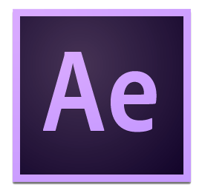
AFTER EFFECTS
The motherload of video editing!
This is it! ENDLESS POSSIBILITIES!
Advanced Video Editing/ Making using third party Plug Ins and effects provided to create anything; anything you wish to make.
create what you imagine!
It requires extensive knowledge of it’s features.
Start from the scratch or Use some Plug Ins and create something, animate it using different tools.
Browse and explore from the vast effects and the applications that comes from it.
15

Slide 21
Some Usages of After Effects
You can either work on a video or make a whole new video.
You have full access & control over everything.
Visually attractive slideshow creation, corporate product / app presentation....
Cloning, Element 3D, 2.5D Animation, Advanced Motion tracking 2D & 3D, Camera & 3D movement, Warp Stablizer, Animations, Volumetric Fog and much much more...
Templates This is a shortcut to get serious output in a very short time.
16

Slide 22
Install After Effects
Run Setup
Install
Crack
Open
Note: After Effects requires much more processing and rendering power. If your PC does not meet the minimum requirements to run it, then it will lag and will be hard to work with. It might even crash at times since after effects requres a lot of power to work with it
17

Slide 23
Any doubts or Inquiry, feel free to contact me
Mujahid Omer
+91 972 901 28 26
Contact Me
mjdmujahid.96@gmail.com

Slide 24
Thanks for Coming

